Slide 1

Mini Project (KCA353) Odd Semester Session 2024-25
Bquick
Upasana Chaudhary 2300290140197
Tanu 2300290140191
Sunny Kushwaha 2300290140089
Sneha Rani 2300290140184
Project Supervisor:
Mr. Amit Kumar
Ass. Professor

Slide 2
Content
Introduction (1 slide)
Literature Review (2 slides)
Objective of the Project (1 slide)
Technology
Hardware Requirements (Development Environment, Server requirement (if required), Client requirement (if required).
Software Requirements (Language and Platforms like Frameworks, VS code, Android Studio and Jupyter notebook etc. )
Modules (2-3 slides)
Workflow (1 slide)
Reports (For Example: Project : Student Monitoring System, so reports like: Student Marks, Subjects, companies visit, and student appears in placement etc.)
References (1 slide)
Notes:
Font Styles: Times New Roman + Font Size: 25

Slide 3
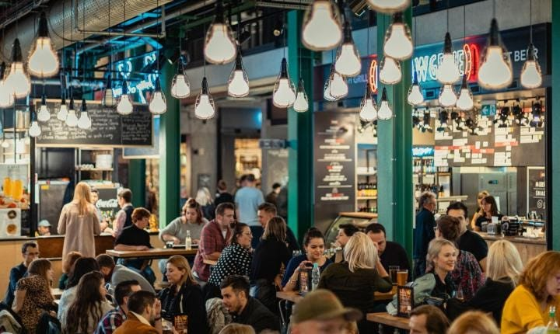
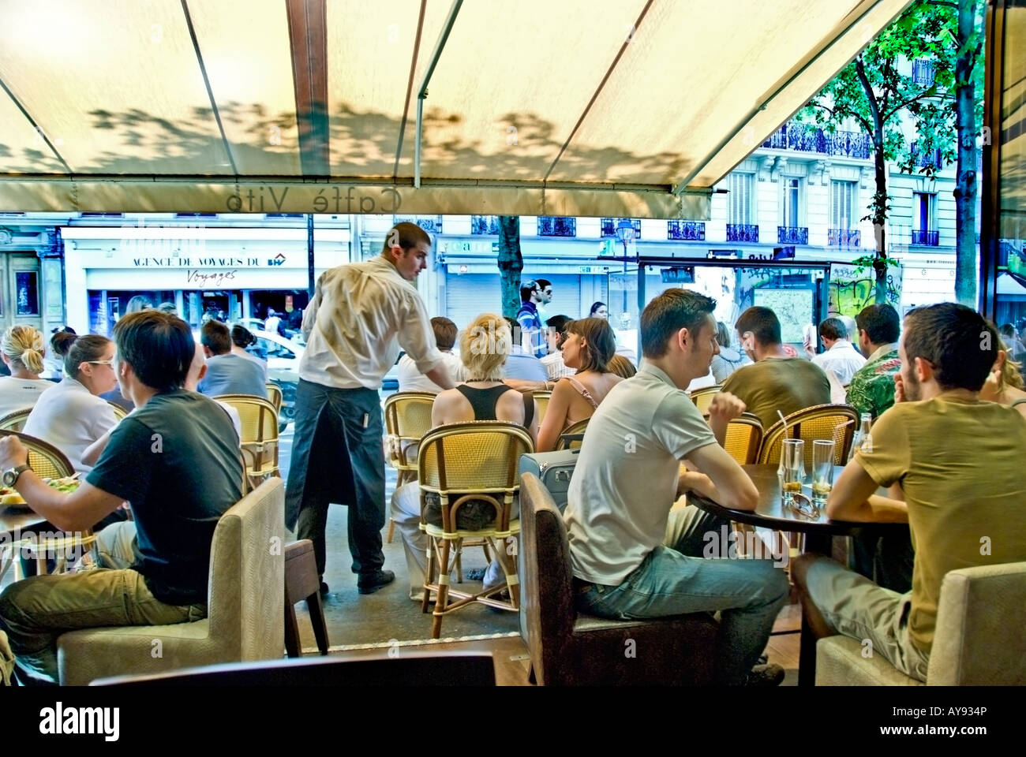
Introduction
As a restaurant owner, managing large crowds during peak hours can be hectic. To address this issue, We developed a Food Ordering Website specifically designed to streamline the ordering process and enhance customer experience. The website provides a convenient platform for customers to browse the menu, place their orders online, and either pick up their food or have it delivered.
Now i optimize kitchen workflow, and minimizes wait time. This system helps ensure that customers enjoy a smoother and more efficient dining experience, even during busy periods that enabling better crowd control.
Notes:
Font Styles: Times New Roman + Font Size: 25

Slide 4
Literature Review
Past Challenges: Managing Peak-Hour Crowds
As a restaurant owner, managing large crowds during peak hours has traditionally been a challenging task. Long wait times, congested ordering counters, and miscommunication between the kitchen staff and customers have often led to inefficiencies. Customers experienced frustration due to delays in service, incorrect orders, and overcrowding, which could lead to a poor dining experience and reduced customer retention.
Lack of Real-Time Order Tracking
Customers had no way to track the progress of their orders once placed. This created uncertainty, and customers had to repeatedly check with the staff to ask when their food would be ready. It also led to bottlenecks at the service counter as customers gathered around, waiting for their food to be called out.
Notes:
Font Styles: Times New Roman + Font Size: 25

Slide 5
Literature Review (Contd.)
Present Solution: Food Ordering Website
To address these issues, we developed a Food Ordering Website that streamlines the ordering process and enhances the customer experience. This website provides a centralized platform where customers can:
Browse the menu online
Place orders for pickup or delivery
Receive real-time order status notifications
This current system has successfully optimized kitchen workflow, ensuring that orders are processed in sequence without overwhelming the kitchen staff. It reduces human error and minimizes wait times, especially during high-traffic periods. Additionally, it improves the overall dining experience by reducing congestion and enabling better crowd control at the restaurant.
Notes:
Font Styles: Times New Roman + Font Size: 25

Slide 6
Technology (Hardware Requirements)
Processor (CPU): Dual-core processor (e.g., Intel i3 or AMD equivalent)
RAM: 4 GB Note: This is suitable for small projects, but may result in slower performance when running multiple services simultaneously (MongoDB, Node.js, etc.).
Storage (HDD/SSD): 20 GB free space (SSD preferred for faster performance, especially for database access)
Notes:
Font Styles: Times New Roman + Font Size: 25

Slide 7
Technology (Software Requirements)
Operating System: Windows
Text Editor/IDE:
VS Code (with Prettier, GitLens extensions)
Node.js and npm:
npm (comes with Node.js
MongoDB (for local development) or MongoDB Atlas (cloud service)
MongoDB Compass (optional, for GUI database management)
GitHub: (for remote repositories)
Browser: Google Chrome
Notes:
Font Styles: Times New Roman + Font Size: 25

Slide 8
Modules
Technology (Software Requirements)
MERN Stack Libraries:
React.js (npx create-react-app)
Express.js (npm install express)
Mongoose (npm install mongoose)
API Testing Tools:
Postman or Thunderx (for API testing)
Notes:
Font Styles: Times New Roman + Font Size: 25

Slide 9
Objective of the Project
User-Friendly Interface
Restaurant Management Integration
Multiple Payment Options
Security and Privacy
Order History and Recommendations
Notes:
Font Styles: Times New Roman + Font Size: 25

Slide 10
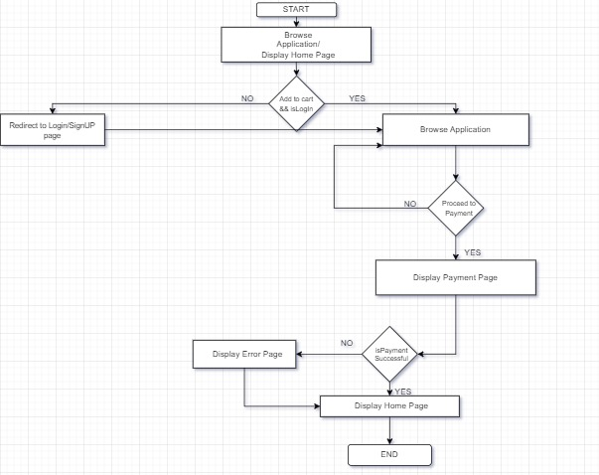
Workflow/Gantt Chart
Notes:
Font Styles: Times New Roman + Font Size: 25

Slide 11


Modules (Contd.)
Login/ Sign up Module
Payment Module
Notes:
Font Styles: Times New Roman + Font Size: 25

Slide 12
Reports
Order Summary Report
Breakdown of pickup vs delivery orders
Peak order times during the day
Customer Activity Report
New customer registrations
Repeat customer statistics
Most frequent order items
Sales Report
Total sales volume (daily, weekly, monthly)
Revenue from pickup vs delivery
Top-selling menu items
Total orders placed (daily, weekly, monthly)
Notes:
Font Styles: Times New Roman + Font Size: 25

Slide 13
References
Zomato / Swiggy Food Ordering Application
Zomato / Swiggy Restaurant Partner Application
upi / paytm payments
Notes:
Font Styles: Times New Roman + Font Size: 25

